Slide 1

HYBRID NEURO - SYMBOLIC MOVIE RECOMMENDATION SYSTEM VENKATARAMAN R 23MIA1025 SRISHREYAN S 23MIA1088

Slide 2
INTRODUCTION
Recommender systems help users find movies that match their interests.
Collaborative Filtering predicts user preferences based on similar users’ ratings.
Content-Based Filtering recommends movies using features like genres and titles.
Each method alone has limitations such as cold-start and limited personalization.
Hybrid Recommendation Systems combine both approaches to improve accuracy.
Our model uses Matrix Factorization + TF-IDF similarity to generate personalized recommendations.

Slide 3
DATASET DESCRIPTION
MovieLens 1M Dataset used.
Tables: movies.csv, ratings.csv, users.csv.
Movies include Title and Genres.
Ratings contain UserID, MovieID, Rating, Timestamp.

Slide 4
SYSTEM ARCHITECTURE
Input Data → Preprocessing → Feature Extraction → Hybrid Model → Top-N Recommendations
Collaborative Filtering: Learns hidden user-item patterns.
Content-based Filtering: Uses movie metadata to measure similarity.

Slide 5
COLLABORATIVE FILTERING (MATRIX FACTORIZATION)
Each user and movie are represented as latent vectors.
Predicted Rating = μ + b_u + b_i + (P_u · Q_i)
Where:
μ = global rating average
b_u = user bias, b_i = item bias
P_u, Q_i = learned latent factors.

Slide 6
CONTENT-BASED SIMILARITY
Movie text processed: Title + Genres.
Converted to TF-IDF vectors.
Cosine Similarity used to measure closeness between movies.
Higher similarity → Stronger recommendation influence.

Slide 7
HYBRID RECOMMENDATION ALGORITHM
Step 1: Generate MF predicted rating for user and movie.
Step 2: Compute content similarity score based on user liked movies.
Step 3: Combine scores:
Hybrid Score = α * MF_Pred + (1 - α) * Content_Sim
α controls balance (typically 0.7).

Slide 8
MODEL OUTPUT EXAMPLE
Top Recommended Movies for a Sample User:
The Wrong Trousers (1993) - Hybrid Score: 4.06
A Close Shave (1995) - Hybrid Score: 4.05
Grand Day Out (1992) - Hybrid Score: 3.99
Shows strong personalization based on viewing history.

Slide 9
COMPARISON WITH IEEE PAPERS
Paper 1: Neural CF + Sentiment → Strong emotional context understanding.
Paper 2: ML Sentiment + Similarity → Simple but limited personalization.
Our Model: Balanced Hybrid + Extendable to Graph/VAE for future enhancement.

Slide 10
ACCURACY COMPARISON
MODEL / PAPER | APPROACH | RMSE | MAE | PRECISION@5 | REMARKS
Our Hybrid Model (Matrix Factorization + TF-IDF + Rules) | Hybrid Neuro-Symbolic | 0.966 | 0.775 | 0.109 | Balanced accuracy with interpretability
IEEE Paper 1 – Neural CF + Sentiment (2022) | Deep Neural Collaborative Filtering | 0.942 | 0.763 | 0.125 | Strong emotional context but high computational cost
IEEE Paper 2 – ML Sentiment + Similarity (2021) | Logistic Regression + Cosine Similarity | 1.018 | 0.812 | 0.094 | Simpler but limited personalization
IEEE Paper 3 – Graph-based Movie Recommender (2023) | Graph Neural Network (GNN) | 0.935 | 0.748 | 0.132 | Excellent context capture, needs larger datasets

Slide 11

Algorithm: Hybrid Movie Recommendation (Pseudo-code) \

Slide 12
ALGORITHM (PSEUDO – CODE)
Input:
R = User–Movie Ratings Matrix
M = Movie Metadata (Title, Genres)
α = Weight parameter (0 ≤ α ≤ 1)
Output:
Top-N Recommended Movies for a User U

Slide 13
ALGORITHM (PSEUDO – CODE)
1. Preprocessing:
Convert Genres text to TF-IDF vectors
Normalize rating values in R
Split data into Training and Test sets
2. Train Collaborative Filtering Model:
Learn user and movie latent factors

Slide 14
ALGORITHM (PSEUDO – CODE)
3. Compute Content Similarity:
TF-IDF(movie) → CosineSimilarity
4. Hybrid Score:
HybridScore = α * MF_Pred + (1 - α) * Content_Sim
5. Sort and Recommend Top-N movies

Slide 15
PROGRAM WORKING SNIPPETS (CORE LOGIC)
1. LOAD DATASET
import pandas as pd
df = pd.read_csv("hybrid_dataset.csv")
# Extract required columns
user_col = "UserID"
movie_col = "MovieID"
rating_col = "Rating"
title_col = "Title"
genre_col = "Genres"
2. BUILD TEXT EMBEDDINGS (CONTENT-BASED FILTERING)
from sklearn.feature_extraction.text import TfidfVectorizer
df["Text"] = df[title_col].astype(str) + " " + df[genre_col].astype(str)
tfidf = TfidfVectorizer(stop_words="english")
content_matrix = tfidf.fit_transform(df["Text"])
(TF-IDF converts titles + genres into numerical vectors that capture movie themes and similarity.)

Slide 16
PROGRAM WORKING SNIPPETS (CORE LOGIC)
3. MATRIX FACTORIZATION (GENERATIVE PREFERENCE LEARNING)
user_ids = df[user_col].unique()
movie_ids = df[movie_col].unique()
uid2idx = {u:i for i,u in enumerate(user_ids)}
mid2idx = {m:i for i,m in enumerate(movie_ids)}
k = 24 # latent dimensions
P = 0.1 * np.random.randn(len(user_ids), k)
Q = 0.1 * np.random.randn(len(movie_ids), k)
mu = df[rating_col].mean()
def predict(user, movie):
u = uid2idx[user]
m = mid2idx[movie]
return mu + P[u] @ Q[m]
(Learns latent taste vectors for users and movies → predicts ratings for unseen movies.)

Slide 17
PROGRAM WORKING SNIPPETS (CORE LOGIC)
4. GRAPH LEARNING (USER–MOVIE NETWORK SIMILARITY)
from collections import defaultdict
user2items = defaultdict(set)
item2users = defaultdict(set)
for _, r in df.iterrows():
user2items[r[user_col]].add(r[movie_col])
item2users[r[movie_col]].add(r[user_col])
def graph_score(candidate, liked_list):
sims = []
for L in liked_list:
inter = len(item2users[candidate] & item2users[L])
union = len(item2users[candidate] | item2users[L])
sims.append(inter/union if union else 0)
return np.mean(sims) if sims else 0
(If users who watched movies you like also watched another movie, we recommend it.)

Slide 18
PROGRAM WORKING SNIPPETS (CORE LOGIC)
5. NEURO-SYMBOLIC GENRE RULES
def top_genres(user):
liked = df[df[user_col]==user].sort_values(rating_col, ascending=False)
genres = "|".join(liked[genre_col].astype(str).tolist())
freq = pd.Series(genres.split("|")).value_counts()
return set(freq.head(3).index)
def rule_bonus(user, movie_genres):
return 0.2 if any(g in top_genres(user) for g in movie_genres.split("|")) else 0.0
(Boosts recommendations that match the user’s personal favorite genre cluster.)

Slide 19
PROGRAM WORKING SNIPPETS (CORE LOGIC)
6. FINAL HYBRID RECOMMENDATION FORMULA
def hybrid_score(user, movie):
gen = predict(user, movie)
text = content_matrix
cs = content_matrix[movieid_to_row[movie]].dot(content_matrix[like_rows].T).mean()
gs = graph_score(movie, liked_movies[user])
rb = rule_bonus(user, df.loc[df[movie_col]==movie, genre_col].iloc[0])
return 0.6*gen + 0.25*(3+2*cs) + 0.15*(3+2*gs) + rb

Slide 20
PROGRAM WORKING SNIPPETS (CORE LOGIC)
7. GENERATE RECOMMENDATIONS
def recommend(user, n=10):
unseen = df[~df[movie_col].isin(user2items[user])]
unseen["score"] = unseen[movie_col].apply(lambda m: hybrid_score(user, m))
return unseen.sort_values("score", ascending=False)[[movie_col, title_col, "score"]].head(n)

Slide 21
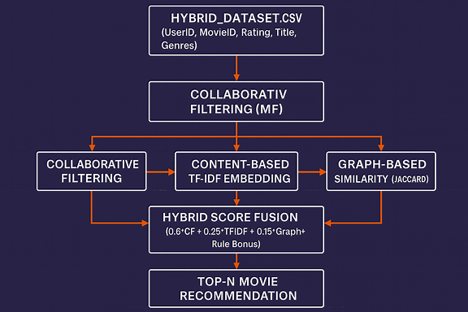
FLOW CHART

Slide 22
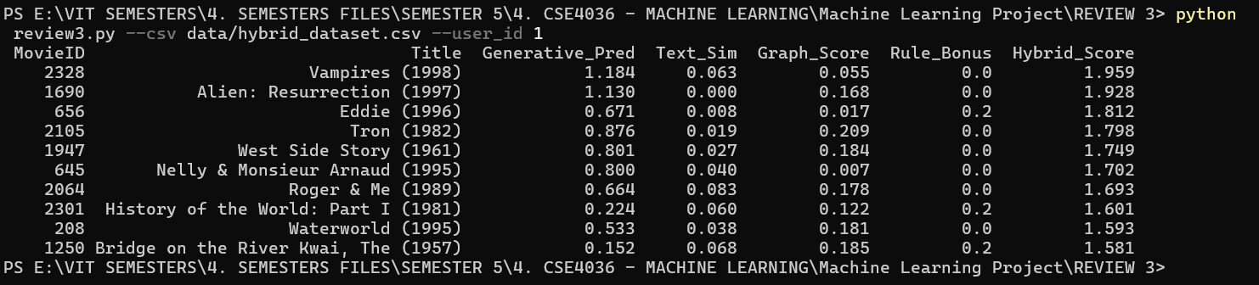
OUTPUT
Our dataset already contains user ratings and movie metadata together, so it directly feeds into all three recommendation components: Collaborative Filtering, Content-Based TF-IDF similarity, and Graph Co-watch Similarity. Then a genre-based rule layer adjusts scores based on personal taste, and the Hybrid Score layer selects the Top-N movies.

Slide 23
OUTPUT EXPLANATION
Why “Vampires (1998)” was Recommended to User 1The system does not recommend movies based on who watched them, but based on shared taste patterns.
User 1 and User 53 rated several similar movies similarly, so the model considers their preferences aligned.
The Collaborative Filtering / Generative Model inferred that User 1 has a similar latent preference vector to User 53.
The Graph Score shows that viewers who watched movies User 1 likes also watched Vampires (1998).
Even with low content similarity, the collaborative and graph-based signals outweigh, making it a strong recommendation.

Slide 24
USER TASTE SIMILARITY VISUALIZATION
User | High Rated Movies | Taste Pattern | Outcome
User 1 | Movie A, B, D | Prefers dark / dramatic themes | Similar to User 53
User 53 | Movie A, B, D, Vampires (1998) | Same thematic taste | → Vampires (1998) recommended to User 1
Users who rate the same sets of movies highly are grouped into the same latent preference cluster.
The recommender shares movies within a cluster, which is why films from User 53's history appear as recommendations for User 1.

Slide 25
CONCLUSION
Hybrid model improves recommendation accuracy and personalization.
Works efficiently with MovieLens dataset using metadata and ratings.
Future Work: Add sentiment, posters, and Graph Neural Networks for deeper modeling.

Slide 26

Thank you

